Slide 1

Moody grade analysis
-Nitin Gowda

Slide 2
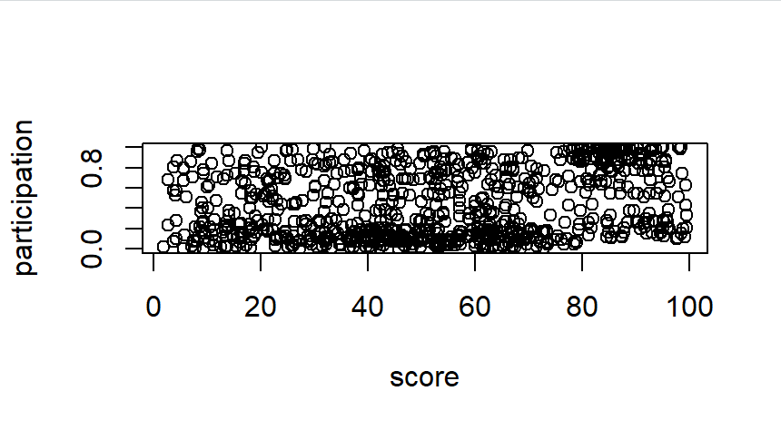
Score vs Participation
In Moody’s class comparing score and participation isn’t a very accurate comparison to find out how Moody is grading students.
Using Moody’s participation score alone isn’t enough to make a comment on his grading
As seen in the plot, students who score low can have a high participation score, and students who score high can have a low participation score

Slide 3
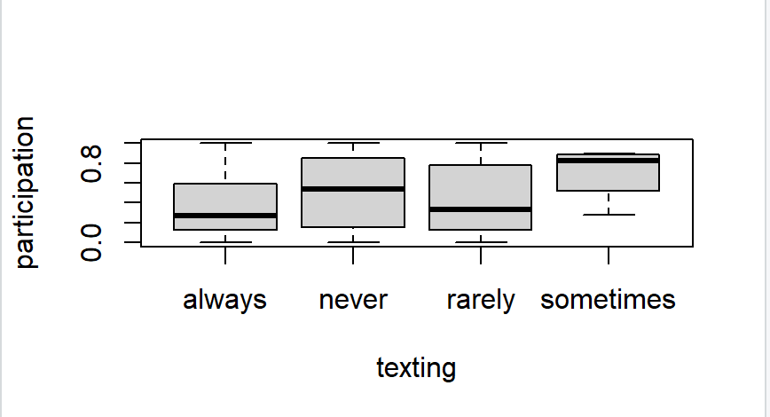
Participation vs texting
As expected, students who are ‘always’ texting get a low participation score.
While students who ‘sometimes’ text do get the highest participation score, there is no exact increase in participation score from ‘never’ to ‘rarely’.

Slide 4
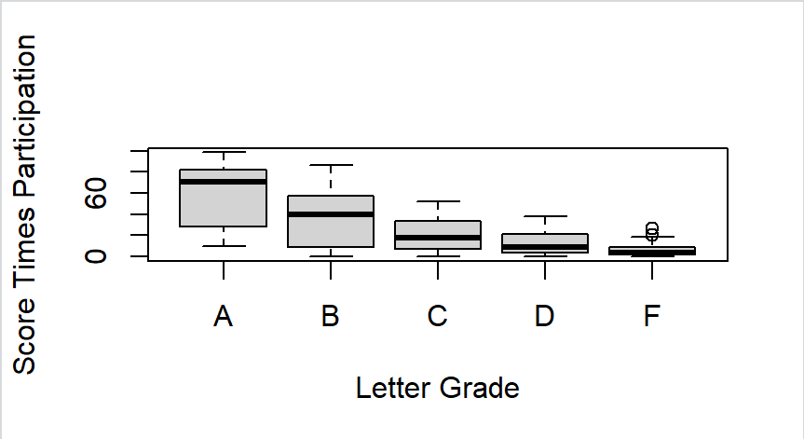
Using a modified participation index
By multiplying score and participation, a modified ‘participation index’ can be found that accurately depicts Moody’s grading.
Clearly students that both participate and score high on tests tend to have higher letter grades.

Slide 5
Uses of this data
The data can be used for students to understand how to get a good grade in Professor Moody’s class, and can be used to study Moody’s interesting grading scheme
The data can be used to come up with new ways to grade students other than just using test scores. Moody’s participation index (calculated on slide 4) is a good way to grade students.

Slide 6
Outcomes from Moody data
Simply ‘participating’ in Moody’s class is not enough
Students need to stay off their phones and avoid texting, while also paying attention in class to get a good participation index
Getting good scores along with staying off your phone is the key to getting a good score in Moody’s class.

